Slide 1
Principal Component Analysis (PCA) Learn How to Manage Data Dimensionality
Without Losing Information

Slide 2
Contents
Need for Data Reduction
2. Relevance of Variation and Correlation
3. Principal Component Analysis (PCA)
PCA General Concept
PCA Using R

Slide 3
The Need For Data Reduction
Explosion in information collection techniques and data availability has resulted in data scientists facing a unique requirement – Need for reducing data.
But how can more information be a problem?
- Not all data fields are useful.
- Variables can be highly correlated or at times redundant
- Most data analysis algorithms work on columns( variables). Large number of
variables may result in slowing down of the process.
Does this mean simply removing data? Definitely not.
Key rule is - Lose data but not information !

Slide 4
What Is High Dimensional Data ?
Simply put, high dimensional data can either be data for several observations with several variables or data with several layers of information.
Majority of the real world analytics - in the fields of medical sciences, ecology, biology, finance, etc. - deals with datasets having a few dozens to hundreds and at times thousands of variables.
Also the number of cases can go up to few millions depending upon the industry.
Consider data maintained by a bank. For each customer, there can be numerous data which can be categorized into transaction data, customer demographics and customer call centre data.
Further, there can be millions of such customers.

Slide 5
Data Reduction
Summarization of data with p variables by a smaller set of (k) derived variables.
These k derived variables are linear combinations of original p variables.
In short, n * p matrix is reduced to n * k matrix.
 | X₁ | X₂ | . | . | . | . | . | . | X_{p}
1
2
.
.
.
n
 | Y₁ | Y₂ | . | . | Y_{k}
1
2
.
.
.
n
Linear Combinations

Slide 6
Variation and Correlation-Key Data Features
Variation in the data is nothing but the information that the data gives.
Few variables in the data can be highly correlated because they possibly measure the same paradigm. This essentially means that they convey the same information.
Example: Employee satisfaction survey asks the following questions:
- Do you think you are rewarded regularly for your work?
- Do you think the system monitoring your performance is flawed?
- Do you get timely encouragement from your supervisors regarding your work?
The above three questions measure the robustness of employee work review. Having three questions to represent a common area can be considered redundant.
Reduction is justified when there is such Correlation present in the data.

Slide 7
Principal Component Analysis (PCA)
PCA is probably the most widely-used and well-known of the “Standard” multivariate methods.
The method was invented by Pearson (1901) and Hotelling (1933).
The method was first applied in ecology by Goodall (1954) under the name “Factor Analysis”. (“Principal Factor Analysis” is a synonym of PCA).
PCA uses correlation structure of original p variables and derives p linear combinations which are uncorrelated.
Each Principal Component provides unique information about the data.
Although ‘p' principal components are derived, first 'k' principal components are expected to explain most of the variability in the data.

Slide 8
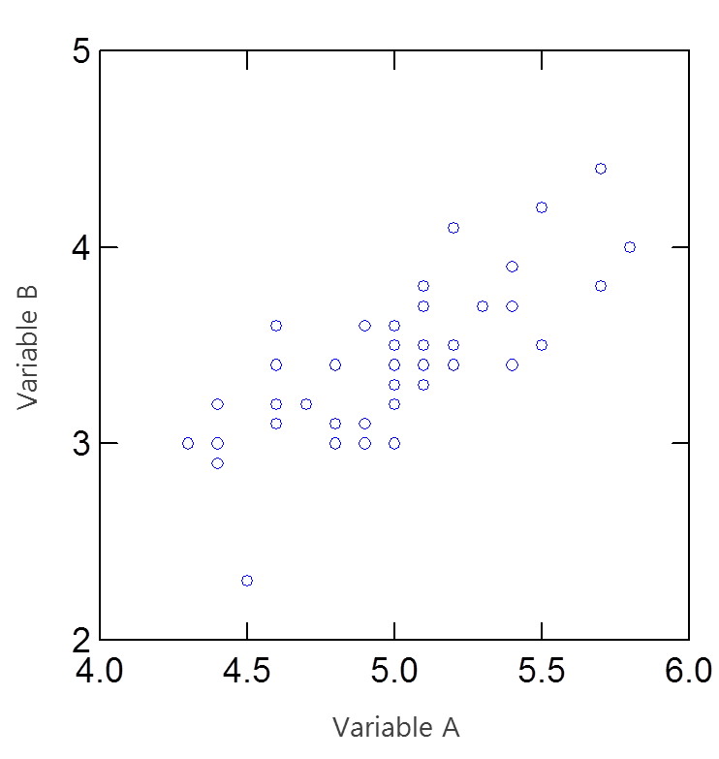
PCA-General Concept
Consider 2 variables A & B (Assume that A & B are features of an object)
A & B have approximately same variance and are highly correlated
Fig. 01
Now suppose we pass a vector through the scatter points such that it is a good linear fit to the data points. This could be considered a new feature of the object which is a linear combination of A & B.
We then plot a second line which is perpendicular to the vector, such that both lines pass through the centroid of the data. This becomes our second linear combination.
2nd Principal
Component, y₂
1st Principal
Component, y₁

Slide 9
PCA – General Concept
From p original variables: x₁,x₂,..., x_{p,} derive p new variables y₁,y₂,..., y_{p}
Although p principal components are derived, data reduction is achieved with first k principal components.
y₁ = a₁₁x₁ + a₁₂x₂ + ... + a_{1p}x_{p}
y₂ = a₂₁x₁ + a₂₂x₂ + ... + a_{2p}x_{p}
.
.
.
y_{p} = a_{p1}x₁ + a_{p2}x₂ + ... + a_{pp}x_{p}
y_{k}'s are
Principal Components
Properties of Principal Components :
y_{k}'s are uncorrelated (Orthogonal).
y₁ explains as much as possible of original variance in data set.
y₂ explains as much as possible of remaining variance. And so on.

Slide 10
PCA – Choice of Matrix Analysis
Which Matrix Should be Used?
Variance-Covariance Matrix
Correlation Matrix
If variables are measured on same units. Even then variables with high variances will dominate principal components.
It is equivalent to using standardized variables.
Better choice for PCA than variance-covariance matrix
*
Correlation matrix of original variables = Variance-covariance matrix of standardized variables.

Slide 11
Principal Components – Definition
Component | Definition
First Component | A linear combination a₁₁x₁ + a₁₂x₂ + ... + a_{1p}x_{p} which has maximum variance among all possible linear combinations, subject to a₁₁ ² + a₁₂ ² + ... + a_{1p} ² =1.
Second Component | A linear combination a₂₁x₁ + a₂₂x₂ + ... + a_{2p}x_{p} which has maximum variance among all remaining linear combinations, subject to a₂₁ ² + a₂₂ ² + ... + a_{2p} ² =1 and zero correlation with first principal component.
Third Component | Similarly third Principal Component is obtained which will be uncorrelated with first and second principal components.
And so on..

Slide 12
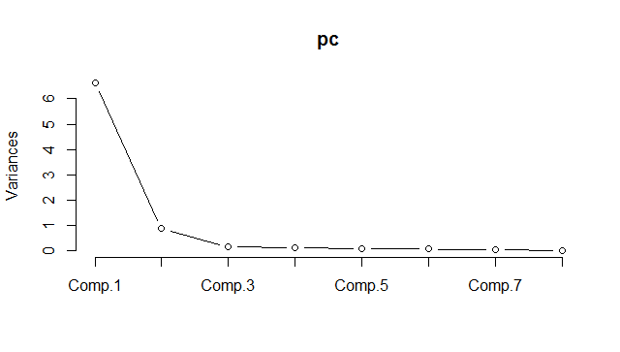
How Many Principal Components to Retain
P principal components are derived but data reduction is achieved with first k PC’s.
Retain principal components associated with Eigen Value more than ‘1’.
Variance of PCs is equal to associated Eigen Value. This is known as “Kaiser Criterion”.
Look at a Scree plot and check for “Elbow" to determine the correct number of PCs to use.
A scree plot shows how much variation each PC captures from the data. The y axis is
eigenvalues, which essentially stand for the variation.
Example of Scree Plot below shows that, first principal component is sufficient to explain
variation in the data.

Slide 13
Case Study – Athletics Records
Background
Objective
Available Information
Data on national athletics records for various countries is available.
To achieve data reduction and obtain score for each country which can be used to rank countries based on athletics records.
Records for 8 different athletics events – 100 meters to Marathon
Sample size is 55 countries athletics.
Data Source: Applied Multivariate Statistical Analysis by Richard A. Johnson , Dean W. Wichern

Slide 14
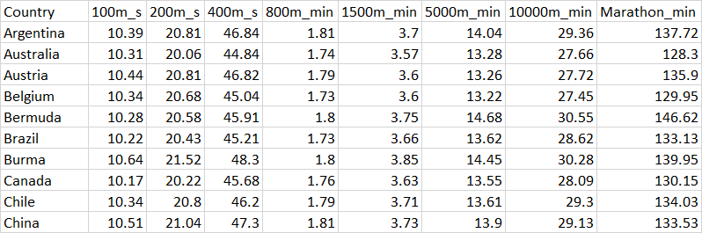
Data Snapshot
Athleticsdata
Variables
Column | Description | Type | Measurement | Possible Values
Country | Country Name | Categorical | - | -
100m_s | Time for 100 meter running | Continuous | Seconds | Positive Values
200m_s | Time for 200 meter running | Continuous | Seconds | Positive Values
400m_s | Time for 400 meter running | Continuous | Seconds | Positive Values
800m_min | Time for 800 meter running | Continuous | Minutes | Positive Values
1500m_min | Time for 1500 meter running | Continuous | Minutes | Positive Values
5000m_min | Time for 5000 meter running | Continuous | Minutes | Positive Values
10000m_min | Time for 10000 meter running | Continuous | Minutes | Positive Values
Marathon_min | Time for Marathon running | Continuous | Minutes | Positive Values
Observations

Slide 15
PCA in R
#Import the data
data<-read.csv("Athleticsdata.csv", header=TRUE)
athletics<-subset(data,select=c(-Country)) pc<-princomp(formula=~.,data=athletics,cor=T) summary(pc)
subset() is used to remove the variable “Country” from the data.
princomp() from base R performs PCA on the given numeric data matrix.
formula= contains the numeric variables.
~. ensures all numeric variables are taken.
cor=T indicates that calculations should be done using the Correlation Matrix. It is equivalent to standardization.

Slide 16
PCA in R
# Output:
Interpretation:
The summary function on object pc gives std. deviation, proportion of variance and cumulative proportion.
First Principal Component explains 83% of the variation. Note that 8 PC’s are derived using 8 variables but first PC explains most of the variation.

Slide 17
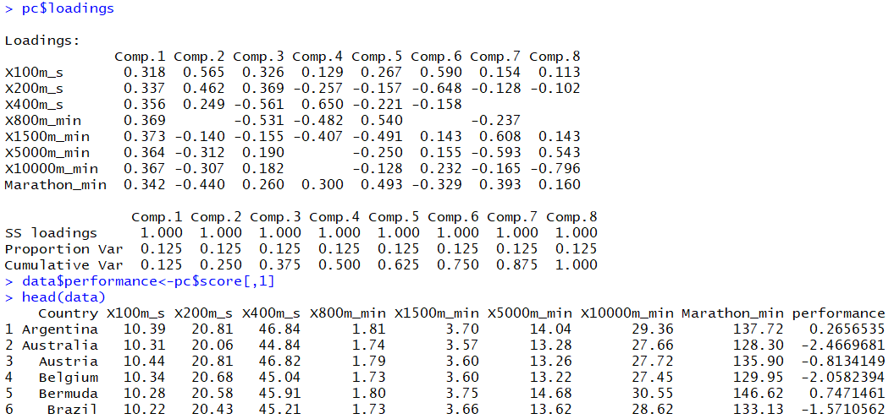
PCA in R –Matrix of Loadings
# Component Loadings
loadings are coefficients in linear combinations
The first column under Comp.1 gives coefficients for first principal component
pc$loadings
# Output:
Interpretation:
First Principal Component can be interpreted as ‘general athletics skill’ since all variables have similar loadings.

Slide 18
Deriving Scores Using PCA
# Adding PCA scores to original data as a new variable:
data$performance<-pc$score[,1] head(data)
# Output:
Interpretation:
New column ‘performance’ stores calculated scores using first Principal Component.
Lower score implies lesser time and hence better athletics performance.

Slide 19
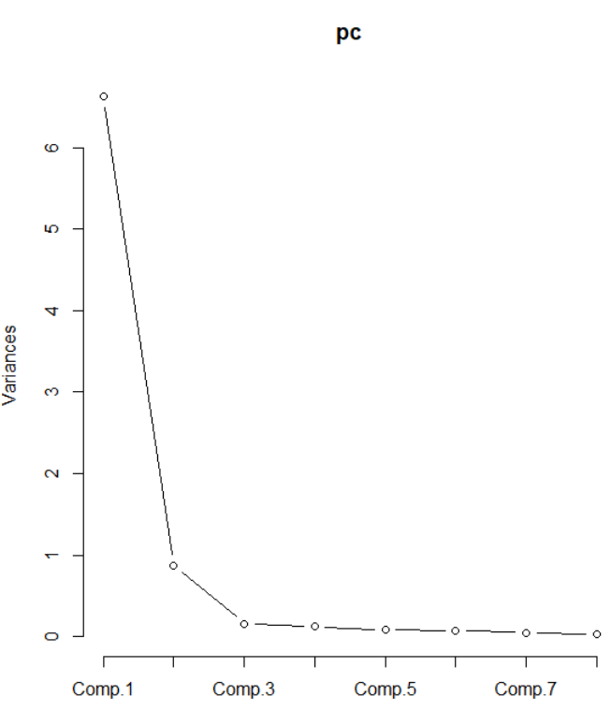
PCA in R - Scree Plot
# Scree Plot
plot() generates a scree plot
plot(pc, type="lines")
# Output:
Interpretation:
First Principal Component is sufficient in explaining most of the variation.
# Plot of country wise performance
plot(data$performance) text(data$performance,label=data$Country,col="red",cex=0.4)
text() is used to assign names to each points in the plot

Slide 20
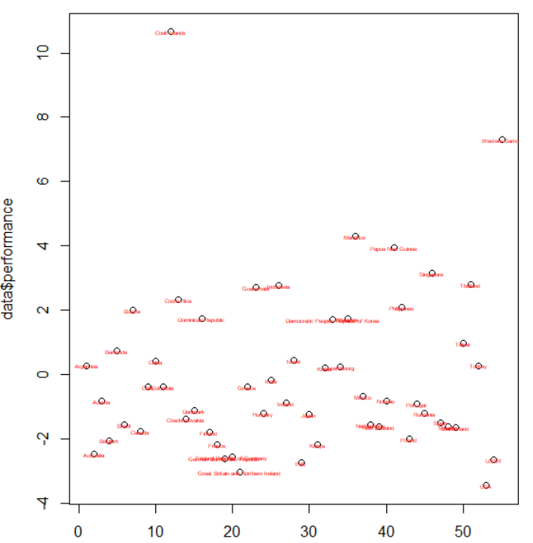
PCA in R –Plot of “Performance”
# Output-plot of country wise performance plot:
Interpretation:
Athletics from country Cook Isands and Western Samoa are performing low since, their score are highest.(lower the score ,better is the performance).

Slide 21
Which are bottom 3 countries?
# head function gives countries with highest “performance”
# In our context, these are bottom 3 countries
top3<-head(data[order(-data$performance),],3) top3
# Output :

Slide 22
Which are top 3 countries?
# tail function gives top 3 countries
bottom3<-tail(data[order(-data$performance),],3) bottom3
# Output :
Interpretation:
USA, Britain and Italy are the top three performing countries.
Cook Islands, Western Samoa and Mauritius are the bottom three countries.

Slide 23
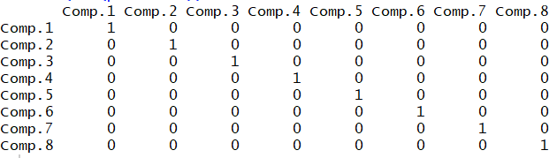
Principal Components Are Uncorrelated
# Correlation Matrix of principal components
round(cor(pc$scores))
round(cor()) calculates rounded correlations of the PCA scores.
# Output:
Interpretation:
Correlation matrix shows that, principal components are uncorrelated. Diagonal 1’s are the correlation of component to itself.

Slide 24
Quick Recap
Data Reduction and PCA
In the age of big data, data reduction is necessary for analysis
Principal Component Analysis is most popular data reduction method.
PCA reduces n * p matrix to n * k where k is smaller than p
PCA – General Approach
Principal Components are linear combinations of original variables
These components are uncorrelated
Retention of components is based on Eigenvalues.
PCA in R
princomp() function in base R performs PCA.
Loadings from the summary output are used to derive new variables

Slide 25
THANK YOU!

